Slide 1
References for MicronesiA An Annotated BiBliography
Femelyne C. Wesolowski
LIBR 210 Reference
San Jose State University
August 4, 2013
Notes:
Assignment 5

Slide 2
Purpose
Provide information about Micronesia for Guam public school teachers and librarians
To meet curriculum needs
To understand cultural background of students with Micronesian heritage
Notes:
Provide talking points as part of communication with family members and community leaders of Micronesian heritage
Note: not all students reside on island with biological parents; may be under legal guardianship of step-parents, aunts/uncles, grandparents

Slide 3
Demographics
Department of Education
Annual State of Public Education Report 2011-2012
Upi Elementary School
4th Quarter Summary Report 2012-2013
Notes:
Identifies percentage of students from Micronesia

Slide 4
26% or ¼ of DOE student population are Pacific Islanders
Notes:
Guam Department of Education. (2012, October). Annual state of public education report: SY 2011-2012. Retrieved from https://sites.google.com/a/gdoe.net/rpe/home/annual-state-of-public-education-report-asper/sy-2011-2012

Slide 5
28% or almost 1/3 of Upi ES student population are Pacific Islanders
Upi Elementary School 2012-2013
Language | K | 1 | 2 | 3 | 4 | 5 | Total
Ilocano | 2 | 3 | 1 | 3 | 3 | 1 | 13
Tagalog | 28 | 29 | 35 | 34 | 34 | 28 | 188
Visayan | 0 | 0 | 1 | 0 | 0 | 0 | 1
Other Filipino Languages | 7 | 0 | 8 | 4 | 1 | 2 | 22
Chamorro | 11 | 5 | 8 | 11 | 13 | 9 | 57
English | 54 | 69 | 42 | 51 | 71 | 49 | 336
Korean | 0 | 0 | 0 | 1 | 0 | 1 | 2
Japanese | 0 | 0 | 0 | 1 | 1 | 1 | 3
Carolinian | 1 | 0 | 0 | 0 | 0 | 0 | 1
Chuukese | 23 | 24 | 22 | 23 | 27 | 23 | 142
Kosraean | 3 | 4 | 1 | 3 | 7 | 4 | 22
Marshallese | 1 | 0 | 1 | 0 | 0 | 1 | 3
Palauan | 1 | 0 | 1 | 1 | 1 | 1 | 5
Pohnpeian | 8 | 5 | 11 | 11 | 11 | 12 | 58
Yapese | 3 | 4 | 3 |  | 1 | 4 | 15
Other Languages | 1 | 0 | 0 | 1 | 1 | 1 | 4
 |  |  |  |  |  |  | 872
Notes:
Wesolowski, F. (2013, June 4). English as a second language program: 4th quarter summary report. (Unpublished document). Upi Elementary School, Yigo.

Slide 6
SOCIAL sTUDIES
Elementary Content Standards and Performance Indicators
Standard 1: Culture
Notes:
Focus on Culture

Slide 7
Introduction
Standard 1. CULTURE
Students learn about the systems of beliefs, knowledge, values, and traditions of various cultures and how those aspects influence human behavior.
Learning about culture helps students to understand themselves as both individuals and members of various groups.
They study complex cultural concepts such as adaptation and assimilation to understand how culture and cultural systems function.
Students learn many perspectives that come from different cultural vantage points within a democratic and multicultural society.
This helps students understand and celebrate the rich cultural diversity within and among people in the Pacific, in the nation, and throughout the world.
Notes:
Guam Department of Education. (2010). K-12 Content standards and performance indicators: Social studies standard 1. Retrieved from https://sites.google.com/a/gdoe.net/curriculum-and-instruction/home/content-standards-1

Slide 8
Performance Indicators
1.1.2 Describe the qualities or distinctive traits of different ethnic groups, faiths, and historical periods after reading or listening to stories about famous people.
1.1.3 Explain that people on Guam and in the U.S. have a variety of different religious, community, and family celebrations and customs, and describe celebrations or customs held by members of the class and their families.
2.1.1 Describe traditional food, customs, sports and games, and music of the place they came from with the help of family members or other adults.
2.1.2 Give examples of traditions or customs from other countries that can be found on Guam and in the U.S. today.
3.1.1 Describe and explain the significance of traditional food, customs, sports and games, and music of the place they came from with the help of family members or other adults.
3.1.2 Explain the origins of traditions or customs from other countries that can be found on Guam and in the U.S. today.
3.1.3 Describe similarities and differences among the cultures in the class and intergenerational groups in communities.
3.1.4 Observe and describe local or regional historic artifacts and sites and generate questions about their function, construction, and significance.
Notes:
Not included
K.1.1 Identify and describe family or community members who promote the welfare and safety of children and adults.
K.1.2 Use the word because in the context of stories or personal experiences correctly.

Slide 9
Performance Indicators
4.1.1 Discuss the similarities and differences of Chamorro traditions and customs with other ethnic groups found on Guam.
4.1.2 Summarize different stories, legends, and myths and explain how they contribute to our understanding of the past.
4.1.3 Recognize the different cultural groups found on Guam and express appreciation for the cultural diversity of the island.
4.1.4 List ways in which one culture can influence other cultures and bring about change.
4.1.5 Compare the ways of life in various Micronesian island groups before European exploration and describe the region in which they lived.
Notes:
Not included
4.1.6 Sing the Guam Hymn in Chamorro and English and explain its meaning.
4.1.7 Describe the origins and significance of local celebrations.
5.1.1 Explain the early relationship of the English settlers to the indigenous peoples, or Indians, in North America, including
the differing views on ownership or use of land and the conflicts between them.

Slide 10
Reference sources
Websites
Notes:
Annotated Bibliography
Focus on reference sources that can help with reference questions

Slide 11
Annotation Format
Publication date:
ISBN:
Format:
Cost:
Frequency:
Topic:
Audience:
Description:
Summary or description of content
Type of information
Format
Justification:
Reviews
Authority of the sources
Awards
Appropriateness for your patrons

Slide 12
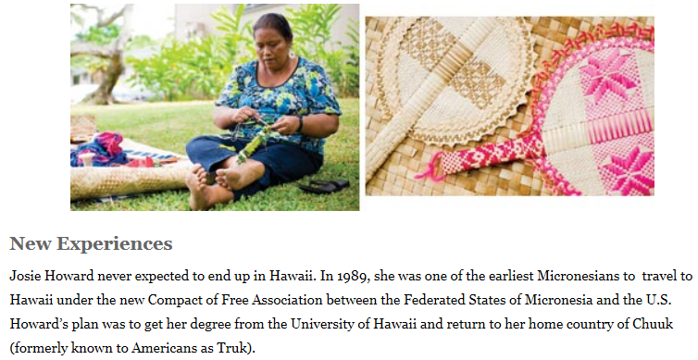
Micronesian in Hawaii
Keany, M. (2011, August). Micronesian in Hawaii. HONOLULU Magazine: News & Opinion. Retrieved from http://www.honolulumagazine.com/Honolulu-Magazine/August-2011/Micronesian-in-Hawaii/index.php?cparticle=3&siarticle=2#artanc
Keany, 2011, p. 1

Slide 13
Micronesian in Hawaii
Publication date: August 2011
ISBN: not indicated
Format: online magazine article
Cost: Digital Subscription: 12 issues @ $14.99/year
Print Subscription: 12 issues @ $20.00/year
Frequency: magazine is monthly
Topic: Micronesians living in Hawaii
Audience: teachers, librarians, counselors, social workers, and parents
Description:
Article Titles: New Experiences; Stepping Forward; Navigating Between Cultures; Moving Up
The article describes the immigration of people from Micronesia and their life in Hawaii: housing;
jobs; schools; discrimination; living life as American and as Chuukese. An important item is the role
of Hawaii resident Josie Howard serving as a link between life in Micronesia to life in Hawaii. She
serves as interpreter and guide in assimilating to a new way of life. The article provides a first hand account of the Micronesian experience in adjusting to life in Hawaii
While there is a political alliance with the United States and a seemingly shared identification as
Pacific Islanders, there is a noted difference between the islanders of Hawaii and the islanders from
Micronesia.
Justification:
Educators of intermediate (Grades 4-5) students can use the article in discussion of similarities and
differences among cultures or in discussion with parents in providing for a more equitable service in
the schools.

Slide 14
Micronesian Culture
HONOLULU Magazine. (2011, August). Micronesian culture. Retrieved from http://www.honolulumagazine.com/Honolulu-Magazine/August-2011/Micronesian-in-Hawaii/Micronesian-Culture/
What is Micronesia, Exactly?; Island Cultures; Family First, Religion, Micronesian Times; Military Service, The Language Barrier; Speak Micronesian; What about the flower skirts?;
Digital Subscription: 12 issues $14.99/year
Print Subscription: 12 issues $20.00/year

Slide 15
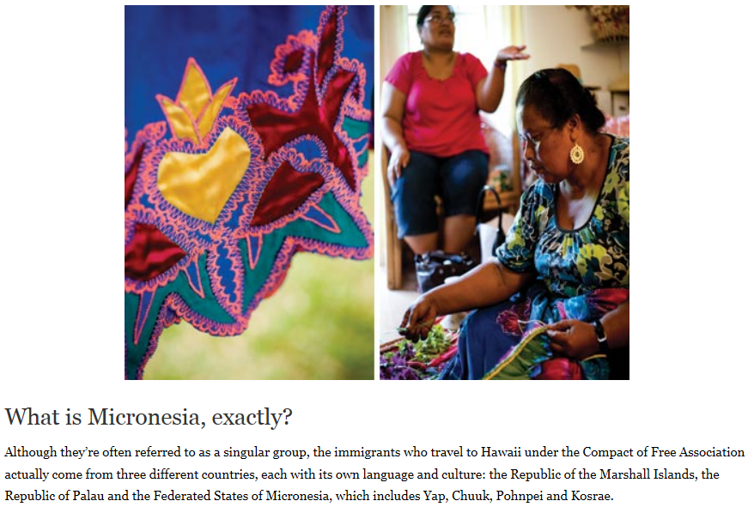
HONOLULU Magazine

Slide 16
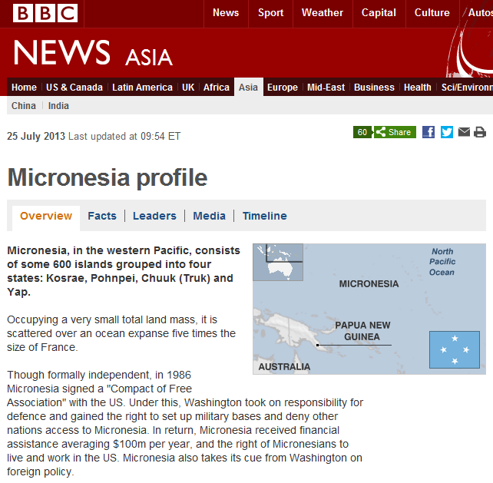

Slide 17
https://www.cia.gov/library/publications/the-world-factbook/

Slide 18
http://www.highbeam.com/

Slide 20
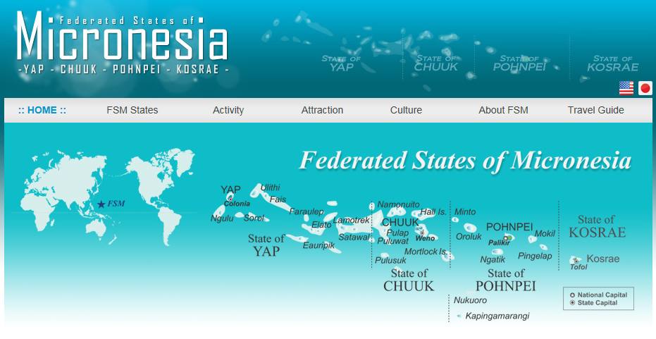
http://www.visit-micronesia.fm/index.html

Slide 21
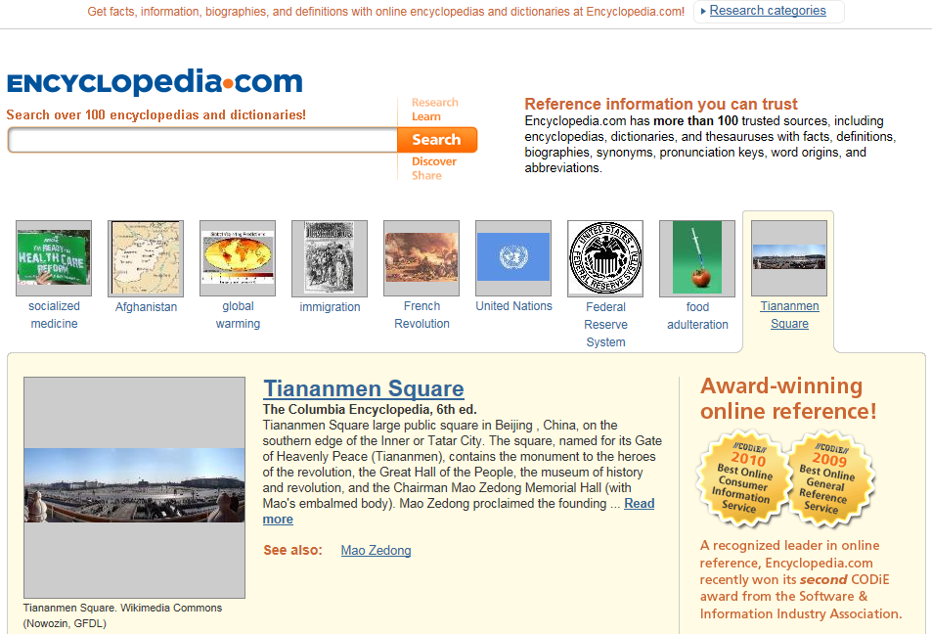

Slide 22
http://www.honolulumagazine.com/

Slide 23
Pacific Heritage Network

Slide 24
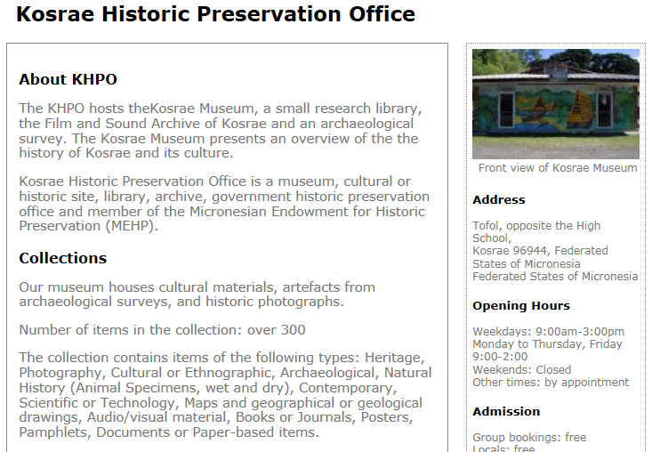

Slide 25
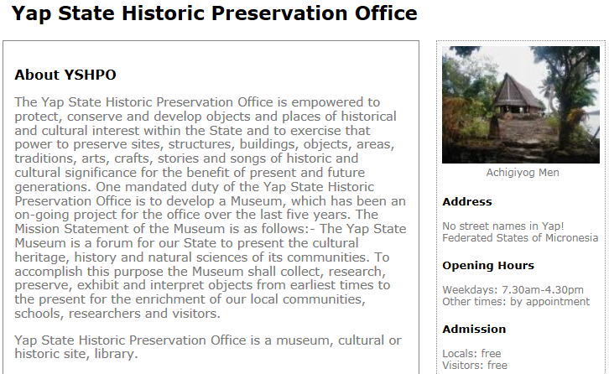

Slide 26
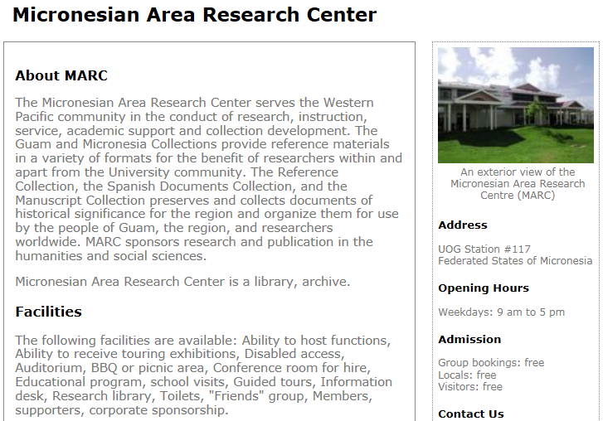

Slide 29
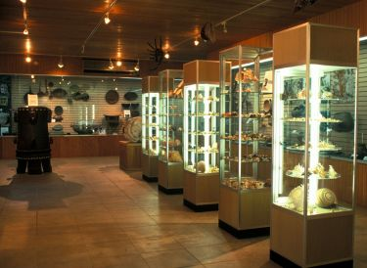
Etpison Museum and Gallery

Slide 30
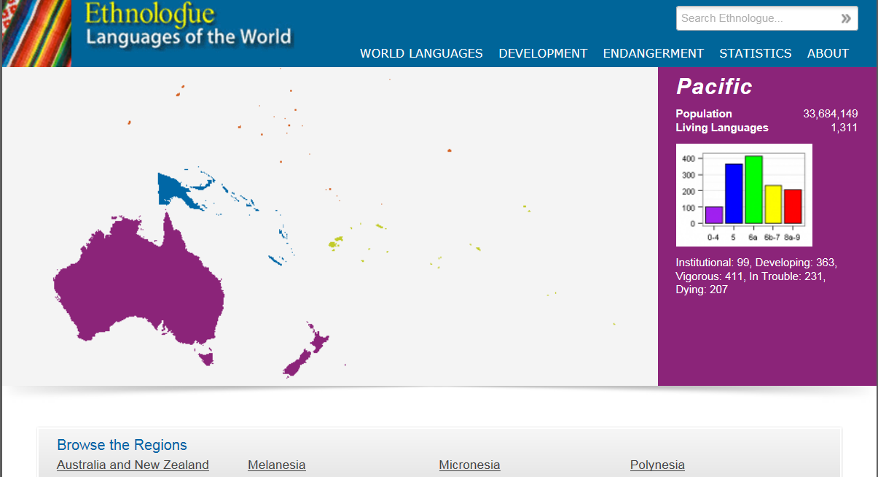

Slide 31
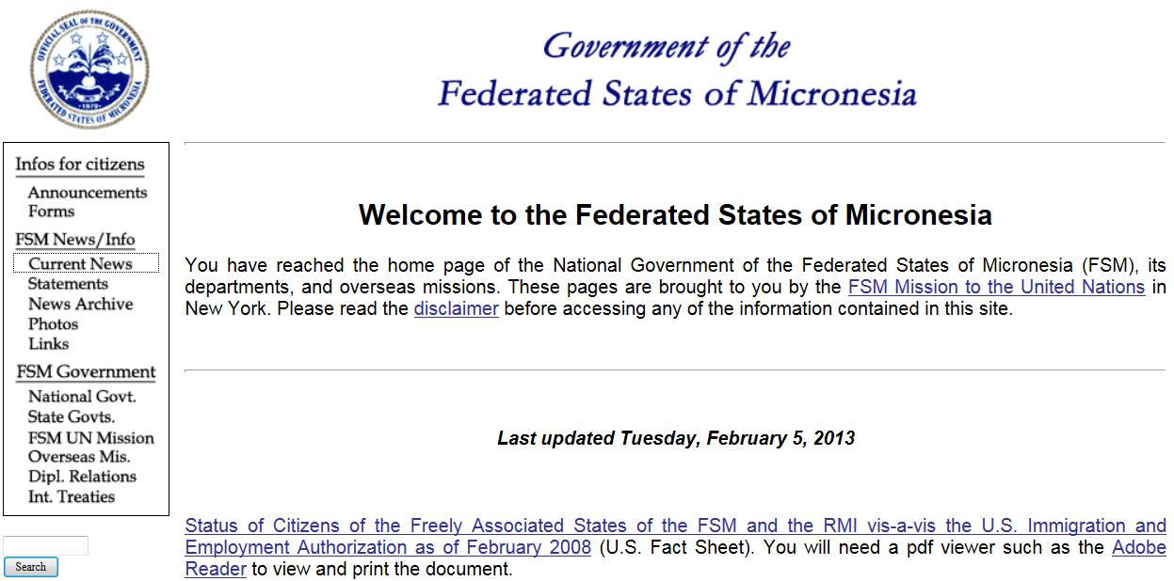

Slide 32
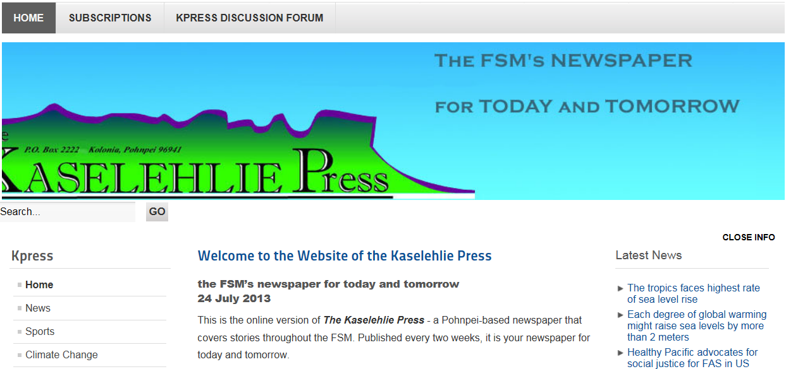
http://www.kpress.info/

Slide 34
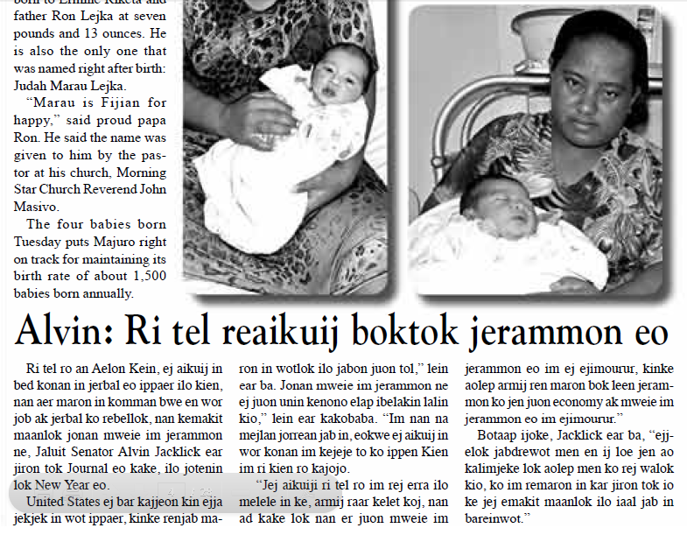

Slide 35
Surf War! A Folktale from the Marshall Islands (book)
MacDonald, M. R. (2009). Surf war! A folktale from the Marshall Islands. Atlanta, GA: August House LittleFolk.
ISBN 9780874838893 0874838894
This story is based on the Marshallese story about the whales and the sandpipers.
Available used for $3.98 from Better World Books

Slide 36
Surf War! A Folktale from the Marshall Islands
Onomatopeia
Recommended as read aloud
Reviews from Goodreads

Slide 37
Folktales Told Around the World (book)
Dorson, R. M., Ed. (1978). Folktales told around the world: Micronesia. Chicago, IL: The University of Chicago Press
ISBN 0-226-15874-8 (paperback) P. 303 –
The book features stories from around the world, including Oceania's Micronesia. Before the story, notes about similar tales are provided. Short information notes are also provided about the narrators.
"More for adults and students of folk/fairytales"
Chris' Reviews from Goodreads https://www.goodreads.com/review/show/39019075
Available for $11.98 at Better World Books http://www.betterworldbooks.com

Slide 38
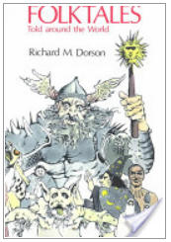
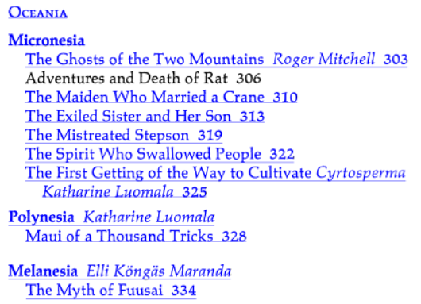
Folktales Told Around the World
From the Table of Contents
Source: Google Books http://books.google.com/books?id=58fqxCNkI5YC&printsec=frontcover#v=onepage&q&f=false

