Slide 1

Cultural Identity & the Micronesian Student
Femelyne C. Wesolowski
LIBR 264
June 29, 2013
Notes:
Hafa Adai! (Guam & CNMI) Tirow! (Carolinian) Mogethin! (Yap) Ran annim! (Chuuk) Kaselehlia! (Pohnpei) Len Wo! (Kosrae) Alli! (Palau) Iokwe! (Marshalls) Hello!
My topic today is on the Cultural Identity of Micronesian students who have immigrated into Guam.

Slide 2
Presentation Outline
Definition of Culture
Description of Geographic Region of Micronesia
Three Influential Factors on Cultural Identity of Youth
  Based on “The Adaptation of Migrant Children”
  Group Race & Ethnicity
  Government Policy
  Co-ethnic Community
Implications for Guam Public Schools
Notes:
I will first, define culture;
second, provide a geographical description of Micronesia;
third, explore three factors which may influence how immigrant Micronesian youth view themselves;
and fourth, provide implications for schools in service of these youth.

Slide 3
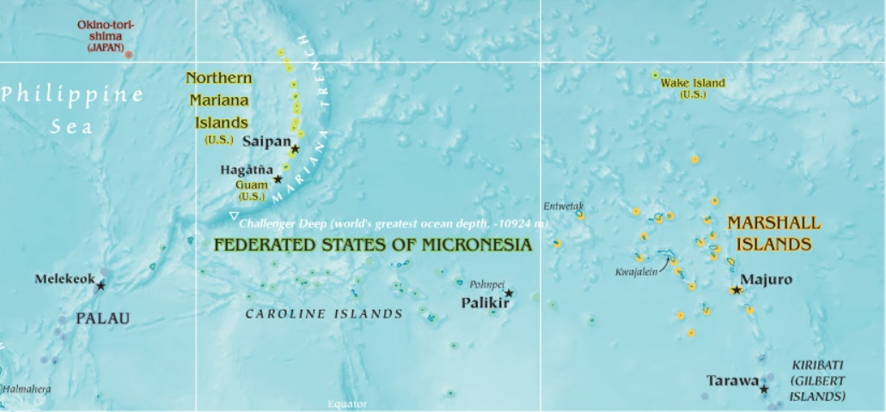
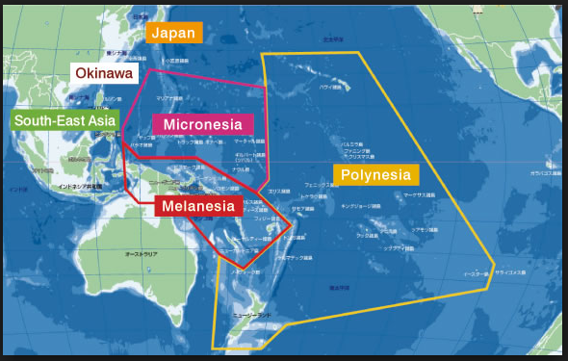
Oceania: Marianas & Micronesia
Notes:
The 3.3 million square miles known as Oceania includes the geographic regions of Melanesia which is just north of Australia, Polynesia, which is to the east of New Zealand and includes Hawaii, and Micronesia.
Micronesia is located in the western Pacific just above Papua New Guinea and Australia and between the Philippines and Hawaii. Guam is an unincorporated territory of the United States of America. It is geographically located at the bottom of the Marianas archipelago. The island nation of the Republic of Palau is located to the southwest of Guam. The four states of Yap, Chuuk, Pohnpei, and Kosrae, which comprise the island nation of the Federated States of Micronesia or FSM, are located to the southeast of Guam. The Republic of the Marshall Islands or Marshalls are farther east of the FSM. Guam and these four island nations make up the Pacific islands of Micronesia.
Guam, which at its longest is 30 miles and at its shortest 4 miles, is one of the largest islands in the Micronesian area. “Where America’s Day Begins!” Guam’s political affiliation with the United States makes it an entryway for many citizens of the surrounding island nations.

Slide 4
Culture
1. “The ideas, customs, and social behavior
of a particular people or society”
2. “The design or plan for living that is passed on
from one generation to another.” (Hezel, 2005, p.8)
language
celebrations
sharing of taboos & wisdom
family and community relationships
art forms
use of natural and man-made resources
Notes:
Culture can be simply defined as the “ideas, customs, and social behavior of a particular people or society.”
It is manifested by the people in their language, celebrations, sharing of taboos and wisdom, family and community relationships, art forms, and use of natural and man-made resources.
Hezel (2005) presents culture as “the design or plan for living that is passed on from one generation to another.” (p.8) This model accounts for the changes experienced in a cultural community.
The objective of this presentation is to begin a discussion of how the cultural identity of immigrant youth is impacted as they settle on Guam, issues they face, and possible implications for educators.

Slide 5
“The Adaptation of Migrant Children”
Alejandro Portes and Alejandro Rivas
2 theoretical viewpoints
  Culturalist – assimilation into mainstream culture (p. 221)
  Structuralist – assimilation into mainstream social hierarchy (p. 222)
    Segmented assimilation
    “Mixed, assimilation may help or hurt social and economic outcomes depending on parental human capital, family structure, and contexts of incorporation” (p. 222)
    3 forces (p. 224)
      Group’s race and ethnicity
      Government policy toward group
      Co-ethnic community
Notes:
In “The Adaptation of Migrant Children,” Portes and Rivas (2011) provide a review of literature that support two theoretical viewpoints of how migrant children adapt to their life in the United States. While the focus of their study is on Asian immigrants and Latino/Hispanic youth, their information sheds light on how Micronesian youth adapt to their life on Guam.
As a full treatment of their report is beyond the scope of this presentation, I will focus on their discussion of three forces under the viewpoint of segmented assimilated which affect how Micronesian youth succeed or not succeed in their new country.
These 3 forces are [1] the group’s race and ethnicity, [2] government policy toward the group, and [3] their co-ethnic community. I will explain each in light of the Micronesian immigration experience, issues they face, and provide implications for schools. Please note that a more extensive and thorough parallel review of literature and or study of Micronesian youth on Guam will be necessary.
Report available at http://futureofchildren.org/futureofchildren/publications/docs/21_01_10.pdf

Slide 6
Group’s Race & Ethnicity
Recognition of culture and cultural values
Shaped by the family
Micronesia viewpoint
  Family is the basic unit
  Property is inherited through the mother
  Property is shared by all members regardless of ownership
  The eldest brother of the mother has the final say
  All adults are recognized as mothers and fathers
  Siblings and cousins are recognized as brothers and sisters
  Each gender has a specific traditional role: men fish, women plant; men walk first, women walk behind
Notes:
The first factor which affect Micronesian youth is recognizing who they are.
Portes and Rivas (2011) state: “…preserving the linguistic and cultural heritage of the home countries often helps migrant children move ahead in America.” (p. 240)
America as a melting pot - that immigrants become one with the host country – is one view. Another is a comparison to “a bowl of fried rice” – each ingredient contributes to the entire dish but retains its unique flavor. (Salas, J. K., personal conversation, 2010) Recognizing the Micronesian youth and their unique cultural characteristics is important in the formation of who they can be in their new country.
Who then are the Micronesian youth?

Slide 7
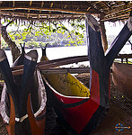
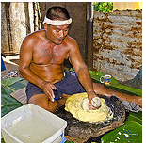
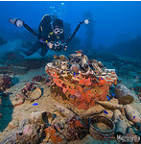
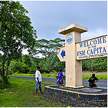
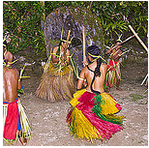
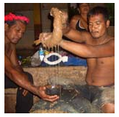
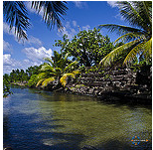
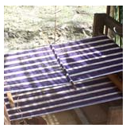
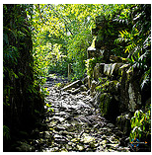
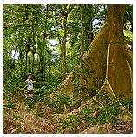
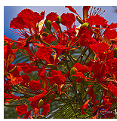
Kosrae
Yap
Chuuk
Pohnpei
Notes:
The people of Micronesia can trace their ancestry to the southeast region of Asia from which voyagers set out in search of new adventures and new lands. In time, they settled in the nearly 20,000 little islands of the Pacific. Micronesians share many cultural similarities but because of time and distance, each island entity has developed its distinct, unique features.
As part of the Federated States of Micronesia, Yap is known for its seafaring skills, giant stone money, and banana fiber lavalava. Chuuk has multiple dialects among its many islands and is known worldwide for its dive sites. Kosrae is made up of two small lush islands, one which has its ancient capital of Lelu made of large hand-hewn stone. Pohnpei is the site of the FSM capital in Kolonia and is known for its beautiful flowers, stone city of Nan Madol, and sakau, ceremonial drink of dignitaries and honored guests.

Slide 8
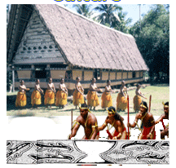
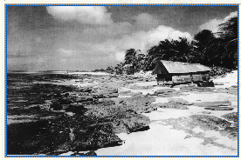
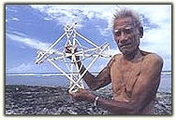
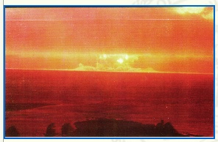
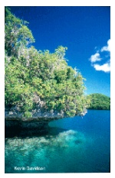
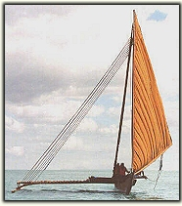
Palau
Marshall Islands
Notes:
Similarities include the importance of traditional extended family; clan systems; oral history; traditional farming and fishing practices; use of tree crops such as breadfruit, coconut and root crops such as taro, yam, and dependence on seafood; value of both the traditional political systems and democratic political practices; and recognized gender roles.
Diversity is seen in the indigenous languages and dialects; folklore and legends; Yap’s caste system; and the Marshalls’ class system.
The Republic of Palau is known for its beautiful reefs among its rock islands, tiny islets, located between its larger islands. The abai, or meeting houses, are decorated with carvings of its legends and myths. Some atolls of the Marshall Islands were the sites of nuclear testing during World Wall II; done at the expense of its people who continue to suffer from the effects of radiation. The Marshallese navigators are also recognized for their handcrafted charts of the ocean swells.

Slide 9
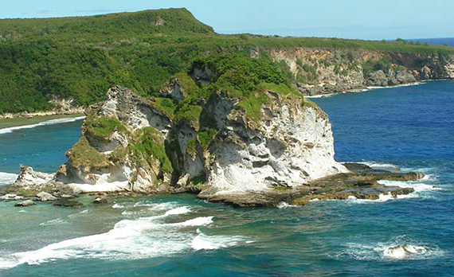
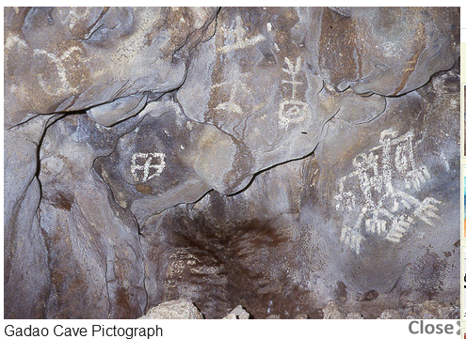
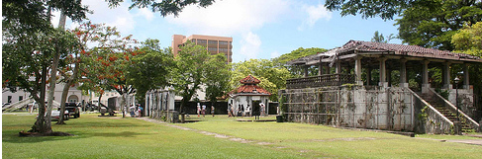
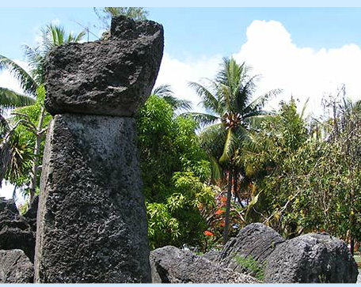
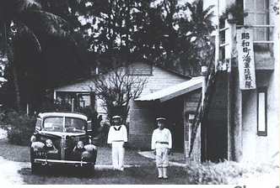
CNMI
Guam
Notes:
Since their European discovery, the Pacific islands have been governed in turn by the Spanish, German, Japanese, and Americans. These groups have greatly influenced the Micronesian people bringing in vocabulary, education, political and economic systems, and new perspectives. Some are relatively beneficial – global connection and new experiences. Some are not – being viewed as “backward and untrustworthy and … lazy, careless, and irresponsible.” (Sharp, 2003, p. 72)
The political relationships and policies of the island nations changed greatly after World War II. Having been territories entrusted to the United States, each eventually became self-governing and choosing political affiliations with the U.S.
The archipelago of the Commonwealth of the Northern Mariana Islands is home to native Chamorros and Carolinians. There are many beautiful tropical sites, including the latte (a as in cat: te-tea) stone quarries. Guam has been claimed by Spanish, American, and Japanese governments throughout its history, affecting its people and its culture.

Slide 10
Government Policy
European discovery and colonialism
American responsibility and dependence
Compact of Free Association and opportunities
  Immigration
  Education
  Job
Micronesian viewpoint
Limited job opportunities
Limited basic resources
Different educational system
English as language of instruction
Future expectations and aspirations
Notes:
What government policies impact Micronesian youth?
First is the political affiliation with the United States. Through the Compacts of Free Association, many citizens of the FSM, CNMI, Palau, and the Marshalls have freely migrated to Guam.

Slide 11
Guam Demographics
Decade | Total | FSM, Palau, Marshalls | Northern Marianas
1980 | 105,979 | 1396 | 2124
1990 | 133,152 | 4285 | 2020
2000 | 154,805 | 8743 | 2183
2010 | 159,358 | 18,979
Notes:
Since 1980, almost 19,000 Micronesians have come to study, to work, to live, or to move further stateside.
Issues which affect the entire family include limited job opportunities because of limited English proficiency or limited skills and experience as well as limited basic resources such as housing, transportation, food and clothing.

Slide 12
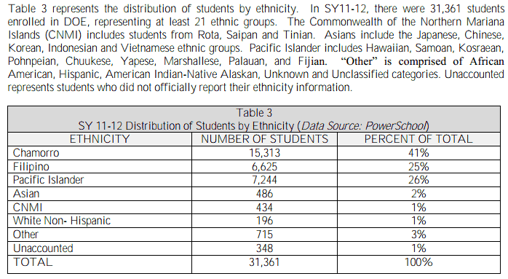
School Demographics
Notes:
As the population grows, Guam’s public schools have also experienced a population shift with the enrollment of Micronesian students. In School Year 2011-2012, Guam’s public schools had 7244 students (26%) from the Pacific islands and 434 (1%) from the CNMI.
The second government policy impact on Micronesian youth is participation in the American educational system. The CNMI and the capital cities of the other island nations may have a similar educational system to Guam’s. The schools in the outer, more remote islands are different.
My students shared that in some Micronesian schools, attendance was not enforced for both students and teachers, books and supplies were limited, and the language of instruction is not English. Their parents shared that the educational system is different; they recognize its importance but defer responsibility to the schools. (personal communication during parent-teacher conferences, 2011)
Issues which affect schooling include adapting to the American school culture, regular school attendance, understanding English, understanding academic language, working with classmates including female relatives, making new friends, recognizing the authority of female teachers.
How do Micronesian youth approach and or overcome these issues?

Slide 13
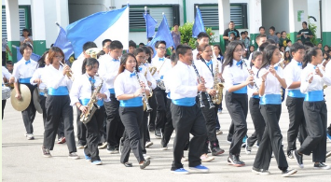
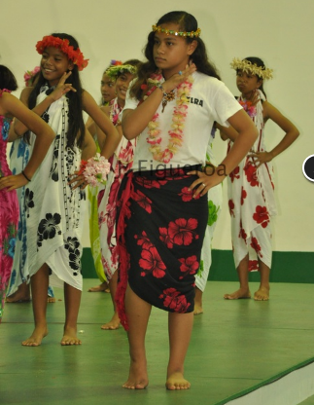
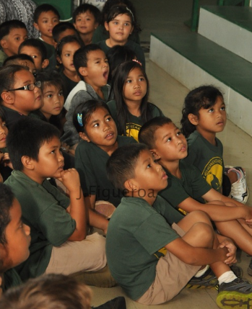
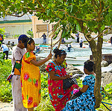
Co-ethnic Community
Notes:
The third force which affect Micronesian youth is the support of their community on Guam. Micronesian families, as with other immigrant families, tend to live within a community of Micronesians - to share basic resources, provide emotional support, and pass on knowledge about how to survive in the host environment.
Issues include limited cross-over into other ethnic communities; limited association with other cultural groups; negative perception by host culture; modeling and imitating inappropriate social behavior such as use of alcohol and drugs, dropping out, disrespect of authority; lowered expectations for school performance and progress.
How do these issues shape the cultural identity of Micronesian youth on Guam?
The following assumptions are offered.
Assumption 1: In the late 1980s, the first generation of immigrants were born and raised in their island nations. Since 1990, many students of Micronesian origins in the public classrooms are born on Guam.
Assumption 2: Many have family members, e.g. parents, grandparents, newly arrived members, who speak their cultures’ languages.
Assumption 3: Many of the second and third generation of immigrant students speak and understand BOTH their cultures’ languages and English OR only understand their cultures’ languages and speak/understand English OR do not speak nor understand their native languages and speak/understand only English.
Assumption 4: Many of these students identify themselves as belonging to their culture but may be more integrated with the dominant Guam culture and school culture.

Slide 14
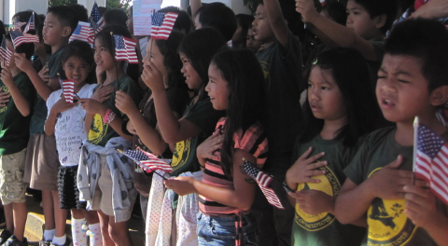
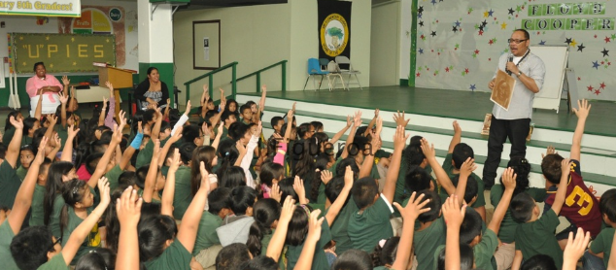
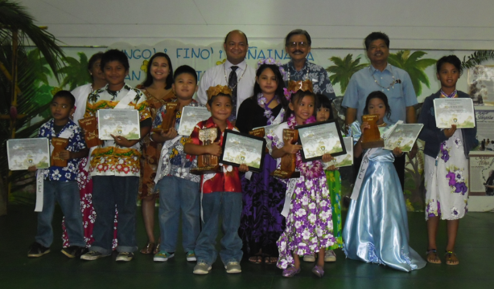
Cultural Identity
Formed within the family
Shaped by the environment
  church, neighborhood, school, media
Influenced by dominant culture
Reflected by a positive or negative self-identity
Notes:
As reported by Chen (2005), a person’s cultural identity is “based on how others judge us [as reflected in the] interaction with the external environment, that is the historical and social contexts (Berger & Luckman, 1967; Erickson, 1968; James, 1997; Laing, 1969; Tatum, 1997)” (p. 12)
External environment may include school, neighborhood, church, community, dominant culture
If the interaction among these entities is “judged” positive or negative, the cultural identity is positive or negative.
How can schools ensure the interaction is positive?

Slide 15
Implications for Schools
Recognize the cultural background of Micronesian youth (Portes & Rivas, 2011; Kawakami, 2003)
Bridge what students know to what they don’t know
Make greater effort to provide resources and opportunities to parents about educational expectations and possibilities for their children (Portes & Hao, 2004)
Teach all students about Micronesia as well as other cultural groups (Kawakami, 2003)
Notes:
Chen (2005) shares that schools pass on “cultural ideologies” and have a responsibility in influencing students’ cultural identities, particularly, students who are not of the dominant culture. (Chen, 2005, p. 13)
Portes and Rivas (2011) write about families who contribute more to the dominant culture will have:
“Their children … learn the language and culture of the host society while preserving their home country language, values, and customs—simultaneously gaining a solid foothold in the host society and maintaining a bond with their parents’ culture.” (p. 225)
Implications for schools
Recognize the cultural background of Micronesian youth (Portes & Rivas, 2011; Kawakami, 2003)
Bridge what they know to what they don’t know, such as learning about how to go to school on Guam
More effort to provide resources and opportunities to parents about educational expectations and possibilities for their children (Portes & Hao, 2004)
Teach all students about Micronesia as well as other cultural groups (Kawakami, 2003)
My hope is that schools and families collaborate so that Micronesian youth know who they are, know their place in society, and know what they can achieve.

Slide 16
Dangkulo Na Si Yu’os Ma’ase’
Maraming Salamat Po
      Ke Kmal Mesulang Palau
      Kini So Chapur Chuuk
      Kulo Maluhlap Kosrae
      Kommol tata Marshalls
      Kalangen en Komwi Pohnpei
      Kam Magar Yap
Thank you!
Notes:
www.elite.net/~runner/jennifers/thankyou.htm

Slide 17
Websites
Culture Whispers: Understanding Micronesian Culture
http://www.salemhealth.org/chec/culture/CW_Micronesia_final.pdf
Oceanic Culture Museum
http://oki-park.jp/kaiyo/en/guide/index.html
The History & Culture of the Pacific Islands
http://www.slideshare.net/DoodeyPoodey/pacific-islands-ppt
The Pacific Islands: Physical Geography
http://www.slideshare.net/mshyland/the-pacific-islands-physical-geography203
Notes:
Selected resources

Slide 18
Reference
Bureau of Statistics and Plans. (2012, November). Guam: 2010 census of population and housing: Demographic profile summary file 2010: Comparative of selected characteristics: 2000 and 2010 censuses. Retrieved from http://www.pacificnewscenter.com/images/pdf/guamdpsf.pdf
Chen, H-J. (2005). The rationale for critical pedagogy in facilitating cultural identity development. Curriculum & Teaching Dialogue, 7(1/2), 11-22. Retrieved from http://web.ebscohost.com.libaccess.sjlibrary.org/ehost/pdfviewer/pdfviewer?sid=33f27b58-e80d-487e-a9b9-97f56560df3f%40sessionmgr115&vid=2&hid=121
Guam Department of Commerce. (2002, February). Profile of general demographic characteristics for Guam: Comparison 1990 and 2000: Island-wide and election district (village) levels. Retrieved from http://www.spc.int/prism/country/gu/stats/publications/Guam%20Profile%201990-2000%20Comparison.pdf
Portes, A., & Hao, L. (2004, May 14). The schooling of children of immigrants: Contextual effects on the educational attainment of the second generation. Proceedings of the National Academy of Sciences of the United States of America, 101 (33) 11920-11927. Published ahead of print July 2, 2004, doi:10.1073/pnas.0403418101
Portes, A., & Rivas, A. (2011). The Adaptation of Migrant Children. Future Of Children, 21(1), 219-246. Retrieved from http://web.ebscohost.com.libaccess.sjlibrary.org/ehost/pdfviewer/pdfviewer?sid=7c3ee0ad-56cd-43a8-89e4-382264984789%40sessionmgr114&vid=2&hid=121
Hezel, F. X. (2005). Loss of culture: How real is the threat? Micronesian Counselor, 56. Retrieved from http://www.micsem.org/pubs/counselor/pdf/mc56.pdf
Kawakami, A. (2003). Where i live, there are rainbows: Cultural identity and sense of place. Amerasia Journal, 29(2), 67-79. Retrieved from http://www.metapress.com.libaccess.sjlibrary.org/content/j482878555087346/fulltext.pdf
Oxford Dictionary. (n.d.) Culture. Retrieved from http://oxforddictionaries.com/definition/english/culture
Sharp, A. W. (2003). Indigenous peoples of the world: The pacific islands. Farmington, MI: Lucent Books.
U.S. Census Bureau. (n.d.). Profile of selected social characteristics: 2010: 2010 Guam demographic profile data. Retrieved from http://factfinder2.census.gov/faces/tableservices/jsf/pages/productview.xhtml?pid=DEC_10_DPGU_GUDP2&prodType=table
U.S. Department of Commerce. (n.d.) Data and reports: 1980 census of population and housing. Retrieved from http://bsp.guam.gov/1980_Guam_Pop_and_Housing_Census.pdf
Notes:
Used in text

Slide 19
Reference: Maps & Images
About.com. (2013). The geography of oceania. Retrieved from http://geography.about.com/od/specificplacesofinterest/a/oceania.htm
FSM Visitors Board. (2012). History. Retrieved from http://www.visit-micronesia.fm/about/index.html#07
FSM Visitors Board. (2012). FSM states: Welcome to chuuk: Photo gallery. Retrieved from http://www.visit-micronesia.fm/state/c_photo.html
FSM Visitors Board. (2012). FSM states: Welcome to kosrae: Photo gallery. Retrieved from http://www.visit-micronesia.fm/state/k_photo.html
FSM Visitors Board. (2012). FSM states: Welcome to pohnpei: Photo gallery. Retrieved from http://www.visit-micronesia.fm/state/p_photo.html
FSM Visitors Board. (2012). FSM states: Welcome to yap: Photo gallery. Retrieved from http://www.visit-micronesia.fm/state/y_photo.html
Geographic Guide. (n.d.) Map of the pacific ocean islands. Retrieved from http://www.geographicguide.com/oceania-map.htm
Guampedia. (2009). Ancient chamorro era gallery. Retrieved from http://guampedia.com/ancient-guam-era-gallery/
Guampedia. (2009). WWII-japanese era gallery. Retrieved from http://guampedia.com/wwii-japanese-era-gallery/
Marianas Visitors Authority. (n.d.) Home. Retrieved from http://www.mymarianas.com/default.asp
Palau Visitor’s Authority. (2003). Things to do. Retrieved from http://www.visit-palau.com/thingstodo/search/search_results_dsp.cfm?CFID=2664211&CFTOKEN=62851250
Palau Visitor’s Authority. (2003). About palau: Culture. Retrieved from http://www.visit-palau.com/aboutpalau/culture.html
RMI Embassy. (2008). Culture. Retrieved from http://www.rmiembassyus.org/Culture.htm
RMI Embassy. (2008). Nuclear issues. Retrieved from http://www.rmiembassyus.org/Nuclear%20Issues.htm
Upi Elementary School. (n.d.). Students. Retrieved from http://upielementaryschool.weebly.com/students.html
Wikipedia. (n.d.) File: Flag of chuuk. Retrieved from http://en.wikipedia.org/wiki/File:Flag_of_Chuuk.svg
Wikipedia. (n.d.) File: Flag of guam. Retrieved from http://en.wikipedia.org/wiki/File:Flag_of_Guam.svg
Wikipedia. (n.d.) File: Flag of kosrae. Retrieved from http://en.wikipedia.org/wiki/File:Flag_of_Kosrae.svg
Wikipedia. (n.d.). File: Flag of palau. Retrieved from http://en.wikipedia.org/wiki/Flag_of_Palau
Wikipedia. (n.d.) File: Flag of Pohnpei. Retrieved from http://en.wikipedia.org/wiki/File:Flag_of_Pohnpei.svg
Wikipedia. (n.d.) File: Flag of the federated states of micronesia. Retrieved from http://en.wikipedia.org/wiki/File:Flag_of_the_Federated_States_of_Micronesia.svg
Wikipedia. (n.d.). File: Flag of the marshall islands. Retrieved from http://en.wikipedia.org/wiki/File:Flag_of_the_Marshall_Islands.svg
Wikipedia. (n.d.) File: Flag of the northern mariana islands. Retrieved from http://en.wikipedia.org/wiki/Flag_of_the_Northern_Mariana_Islands
Wikipedia. (n.d.) File: Flag of yap. Retrieved from http://en.wikipedia.org/wiki/File:Flag_of_Yap.svg
Notes:
Maps and images

