Slide 1
National Geographic Kids @ GPLS: Guam Public Library System
How to Go There & What to Get There
Femelyne C. Wesolowski
LIBR 210 Reference San Jose State University
July 7, 2013
Notes:
Hafa Adai! Let’s find out what’s happening with National Geographic Kids at the Guam Public Library System. You can find out how to go there and what to get there from your computer!

Slide 2
National Geographic Society
Mission
to care for our planet Earth
Goals
Conserve our natural resources
Learn about plants, animals, & their homes
Learn about problems that affect them
Research, Exploration, Education
Notes:
The National Geographic Society was created in 1888 to help us take care of our planet earth and its natural resources. It provides human and financial resources in gathering information about our natural resources, plants, animals and their homes, the problems that affect them and then sharing that information through its popular magazine the National Geographic Magazine, books, newsletters, films, radio and television programs, music and videos, and through the Internet.
The Guam Public Library Systems has linked to its kid-friendly site: National Geographic Kids but parents, teachers, and the whole community can use it.
Let’s find out How to Get There.

Slide 3
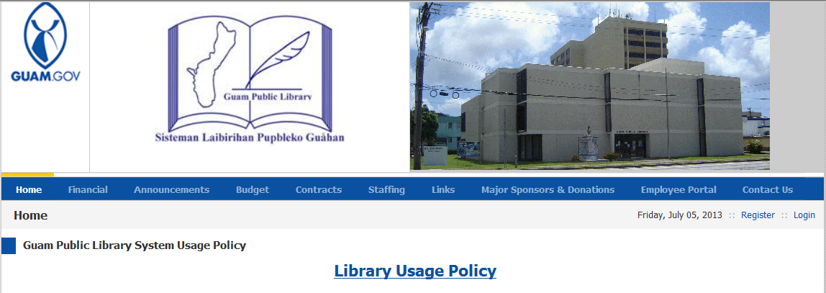
GPLS Website http://gpls.guam.gov/
Notes:
First go to the Guam Public Library website at http://gpls.guam.gov/.
On the home page you will see a picture of the main branch, the Nieves M. Flores Memorial Library, which is located in the capital village of Hagatna.
Under the picture, you will see the 9 tabs that will give you various information about the library.

Slide 4
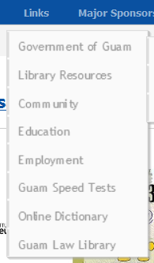
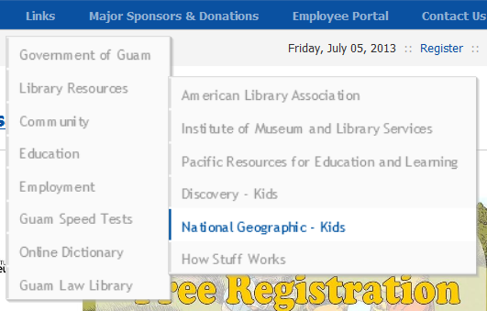
Links – Library Resources
Notes:
Move to the Links tab which drops open a box, mouse down to Library Resources, which drops open another box; then mouse down to National Geographic : Kids, and click!

Slide 5
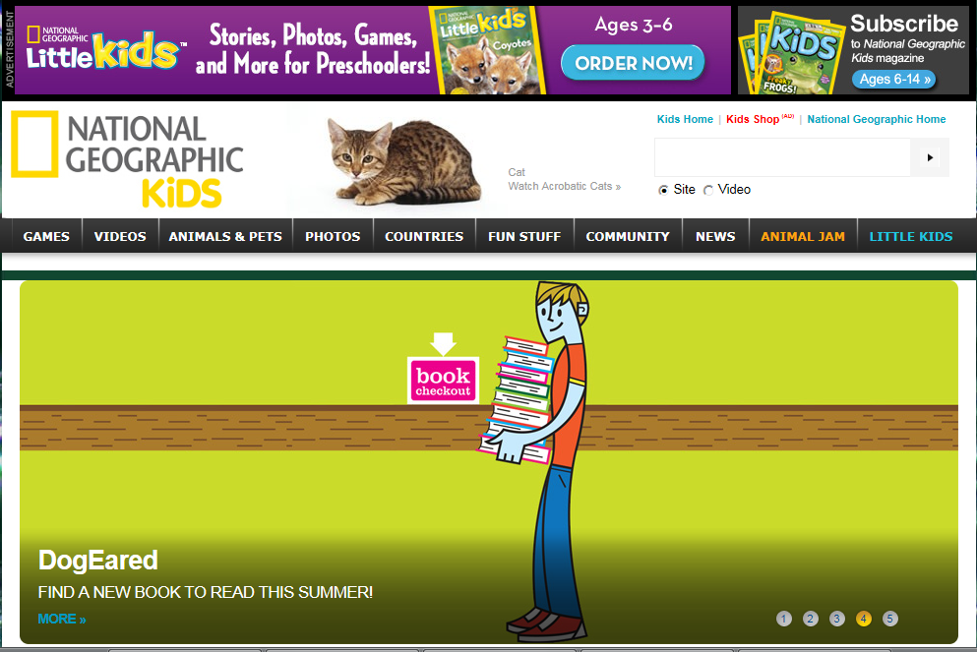
National Geographic Kids
Notes:
On the home page of National Geographic Kids, you will see 10 tabs that are full of information about our planet Earth. We will check each tab and explore some information of What to Get There.
Let’s begin!

Slide 6
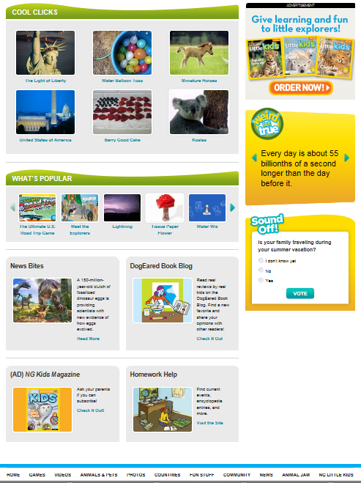
Home Features
Cool Clicks
What’s Popular
News Bites
DogEared Book Blog
(AD) NG Kids Magazine
Homework Help
Notes:
As you visit each section on the NG Kids, you will see three areas that features what is cool, what is popular, more information links on the bottom , and tidbits on the side. Please note that the titles will change for each tabbed section.
Cool Clicks – highlights the latest and interesting sections on the site
What’s Popular – shows the most visited sections
On the bottom, there are always two or more links to regular features such as
News Bites – a blog that gives quick info about recent headlines under the News
DogEared Book Blog – a blog that tells about all kinds of books that you might be interested in
(AD) NG Kids Magazine – offers parents a subscription to the NG Kids Magazine
Homework Help – is a very helpful feature for students and parents. It links students to Reference and News which includes: Activities and Games; Maps; Photos & Videos – which also offer limits by subject, topic, or grade level as well as links to other features. Homework Help also offers links to Encyclopedia Quick Find; National Geographic Education Blog; Glossary Quick Find; National Geographic MapMaker Kits, Explore the Earth, Meet the Explorers.
Now let’s take a look at the other features.

Slide 7
Games
Notes:
Games features interactive games in many subject areas such as Action, Adventure, Geography, Puzzles & Quizzes, games with characters such as Iggy and Zipper and so many more games!
Be sure to stay on the yellow drop down bar so you can choose the subject area you want.

Slide 8
Games – Cool Games
Notes:
Cool Games features the most interesting and popular games for visitors.

Slide 9
Videos
Notes:
Videos are arranged by subject area as well. Each video ranges from 30 seconds to 3 minutes. These are great for quick information about the topic and whets the appetite to learn more. Two topics feature videos narrated in Spanish and Mandarin, Movies & Books previews contents of NG publications; and My Shot Minute features favorite photo images selected by the NG Editors.

Slide 10
Video: More Info!
Notes:
The Info table under the video gives you a summary of the video as well as links to more or related information.

Slide 11
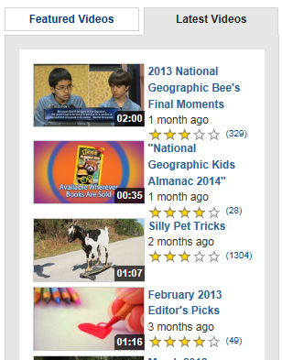
On the Side
Notes:
Featured videos are pre-selected for you and Latest Videos are new additions to the site.

Slide 12
Animals & Pets
Notes:
Animals & Pets Home takes you to the featured animal and Cool Clicks.

Slide 13
Animals - All
Notes:
Go to Animals – All so you can select different Wildlife and their Habitats or specific creatures!

Slide 14
Photos – Photos Home
Notes:
Photos Home gives you the featured image and favorites.

Slide 15
Photos - All
Notes:
Go to All for 89 choices!

Slide 16
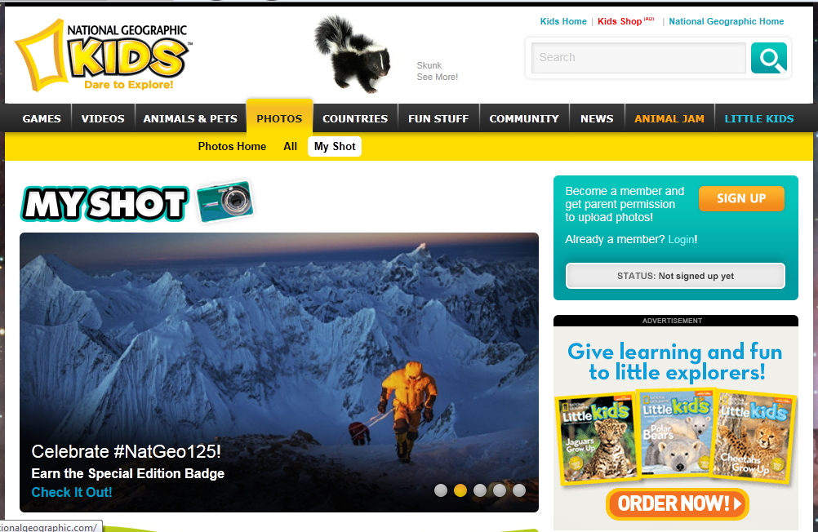
Photos – My Shot
Notes:
If you visit My Shot, sign up to upload your own photos and just maybe, NG Kids will feature it!

Slide 17
Countries - All
Notes:
Click on the tab for Countries – All and choose one continent and then one country to visit. Be sure to read “Note: Not all countries of the world represented below.”

Slide 18
Fun Stuff – Just Joking
Notes:
Fun Stuff is full of, well, Fun! Just Joking!

Slide 19
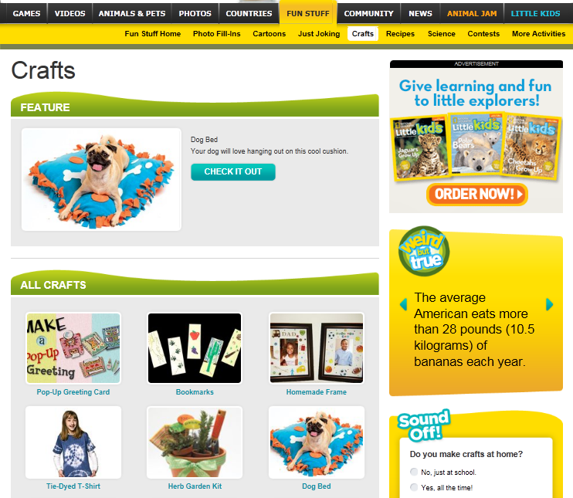
Notes:
Crafts

Slide 20
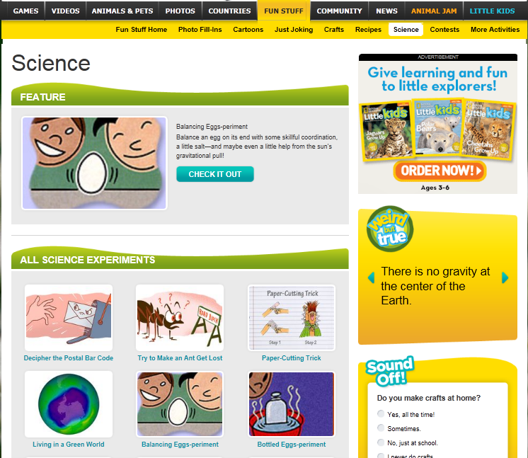
Notes:
Science Experiments

Slide 21
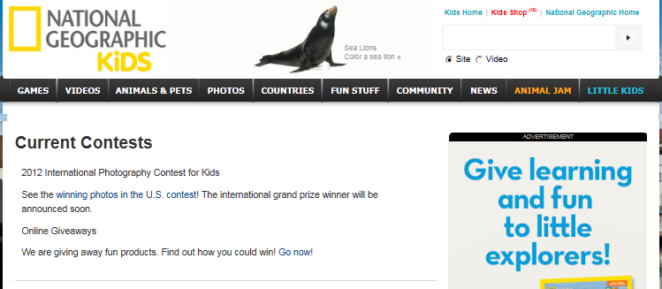
Fun Stuff - Contests
Notes:
and Contests.

Slide 22
Community
Notes:
Community connects you to blogs from NG or from members – just sign up.

Slide 23
Community - Parents
Notes:
Community also has Information for Parents

Slide 24
News
Notes:
News features the latest and interesting news under different subjects as well.

Slide 25
Animal Jam
Notes:
Animal Jam takes you to an interactive site on which kids can play and contribute.

Slide 26
Little Kids
Notes:
Little Kids are features for the youngest members in the family.

Slide 27
More!
Notes:
There are so many activities to do on National Geographic Kids. Explore it @ the Guam Public Library System!

Slide 28
Go to http://gpls.guam.gov/
Notes:
Microsoft Corporation. (2013). Girl smiling while at computer. Retrieved from http://office.microsoft.com/en-us/images/results.aspx?qu=computers&ex=1#ai:MP900426562|

Slide 29
Reference
Guam Public Library System. (2007). Home: Mission statement and goals. Retrieved from http://gpls.guam.gov/
Microsoft Corporation. (2013). Girl smiling while at computer. Retrieved from http://office.microsoft.com/en-us/images/results.aspx?qu=computers&ex=1#ai:MP900426562|
National Geographic Society. (1996-2013). Press room: About the national geographic society. Retrieved from http://press.nationalgeographic.com/about-national-geographic/
Notes:
Links may not be available; but you can open them onto your server.

Slide 30
Guam Public Library System
Mission
Serving Guam residents since 1949, our mission is to provide free and open access to information and ideas fundamental to a democracy. The library system will protect intellectual freedom, promote literacy, encourage lifelong learning, and maintain cultural materials (GPLS, 2007, Home)
Location
Northern Guam: Dededo
Central Guam: Barrigada, Hagatna – main
Southern Guam: Agat, Merizo
Notes:
GPLS wants to keep you informed!

Slide 31
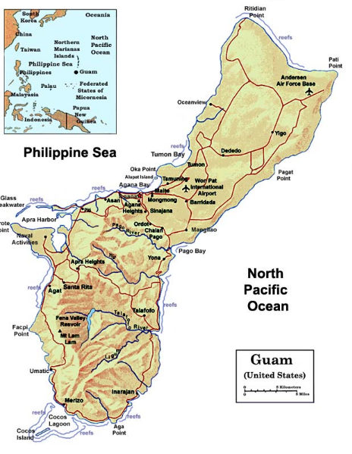
Nieves M. Flores Memorial Public Library – main branch
254 Martyr Street Hagåtña, Guam
Dededo Public Library
283 West Santa Barbara Avenue
Dededo, Guam
Barrigada Public Library
177 San Roque Drive
Barrigada, Guam
Maria R. Aguigui Memorial Library
165 Follard Street Agat, Guam
Rosa Aguigui Reyes Memorial Library
376 Cruz Avenue Merizo, Guam
Notes:
Where on Guam is my library?!

