Slide 1
Poem On!
April is National Poetry Month

Slide 2
Lesson Ideas
lesson idea from Regie Routman
https://www.scholastic.com/teachers/teaching-tools/articles/lessons/kid-s-poems--how-to-introduce-poetry-into-the-elementary-school-.html
lesson idea for 5 easy steps to write a poem
https://youtu.be/-HrT5CnTrpc
ideas for every day of Poetry Month
https://poets.org/national-poetry-month/30-ways-celebrate-national-poetry-month-classroom

Slide 3
What is Poetry?
what is poetry Grades 3-5
https://youtu.be/-Lk9SYjHEb4
elements of poems
https://youtu.be/JmkgAWAGtbE
various poets' definitions of "poetry"
https://poets.org/glossary/poetry
for teachers; for inspiration

Slide 4
Poems 1
a poet and his poems
https://poetry4kids.com/
poems written by kids age 5-18
https://www.loriswebs.com/youngpoets/
poems for kids; explore & choose the themes related to interest or lesson
https://poets.org/poems-kids

Slide 5
Poems 2
poems by poets
https://www.poetryfoundation.org/poems/browse#page=1&sort_by=recently_added&filter_poetry_children=1
listen to poetry
https://poetry4kids.com/poetry-for-kids-podcast/

Slide 6
Poems 3
longer but familiar poems to memorize
https://parenting.firstcry.com/articles/15-short-english-poems-for-kids-to-recite/
various poems to share & illustrate & post
https://momlovesbest.com/short-poems-for-kids

Slide 7
Types of Poetry
types of poems
https://www.kathimitchell.com/poemtypes.html

Slide 8
Rhymes
Hibiscus are red;
Plumeria are white;
How beautiful our island in the tropical light
~fcw©2022
type a word to find its rhymes
https://www.rhymedesk.com/kids
https://www.rhymes.com/

Slide 9
List Poems
Marianas Fruit Bat
Flies among the trees, over the jungles, of the Marianas, in the sea
Eats fruits, flowers, leaves, shoots, buds
of the dukduk, fadang, kafu, putting, gaogao, talasi
Fanihi
~fcw©2022
Source: https://www.guampedia.com/fanihi-mariana-fruit-bat/
more than just a list; there's a structure
https://poetry4kids.com/lessons/how-to-write-a-funny-list-poem/

Slide 10
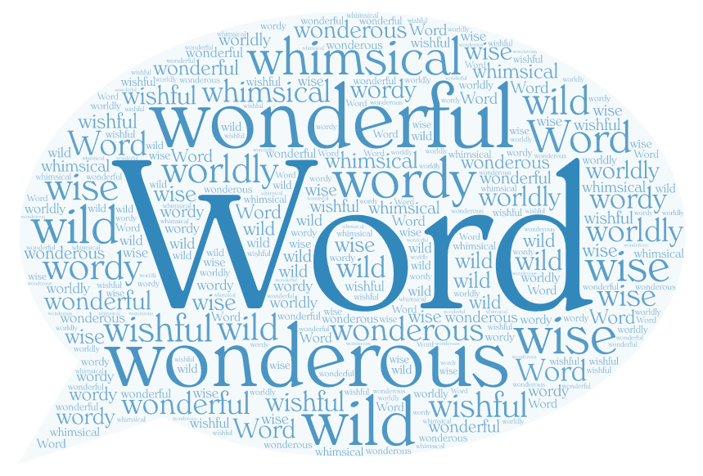
Poem Art
choose theme, list words, choose shape, create
https://wordart.com/
~fcw©2022

Slide 11
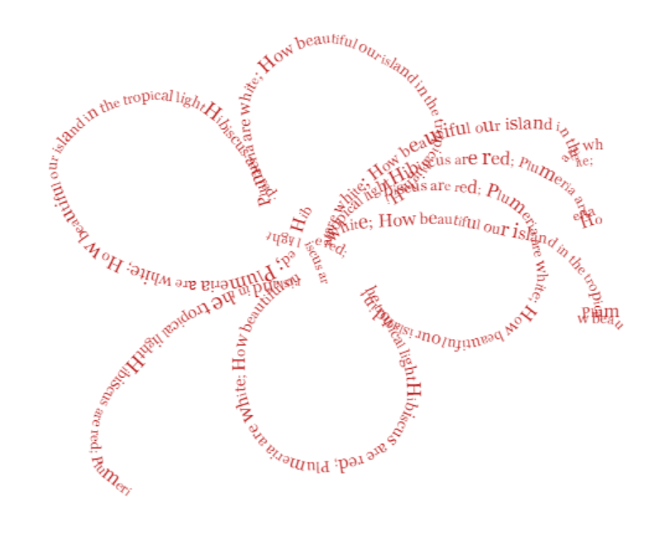
Concrete Poems
Create a poem, “launch,” enter the poem into the Text box, adjust the size and colors, draw an image using the words
https://www.languageisavirus.com/visual-poetry/index.php#.W9za7XrYrdS
Snip and paste image to your document (not sure how to save)
Draw a shape, write the poem on the lines of the shape
~fcw©2022

Slide 12
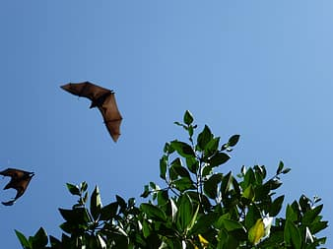
Tongue Twisters
Fantastic Fanihis Fly Fabulously Fast
attempt an alliteration activity
https://ivypanda.com/tongue-twisters
tongue totally tangled!
https://youtu.be/-qWX4KnuQcs

Slide 13
Acrostic Poems
Furry
mAmmal
Night-time
fruIt
Hanging
UpsIde Down
https://youtu.be/E-pCY3YbtJQ
~fcw©2022

Slide 14
Limericks
There was a Fanihi so furry
Who wondered and wondered with worry,
“As I’m flyng quite high
in the big blue sky,
Will I soak up the clouds as I hurry?”
~fcw©2022
https://www.youtube.com/watch?v=Wy65TkCadfU
line 1, 2, 5 rhyme; line 3, 4 rhyme
There once was a ______
Who _________________
He __________________
And _________________
_____________________

Slide 15
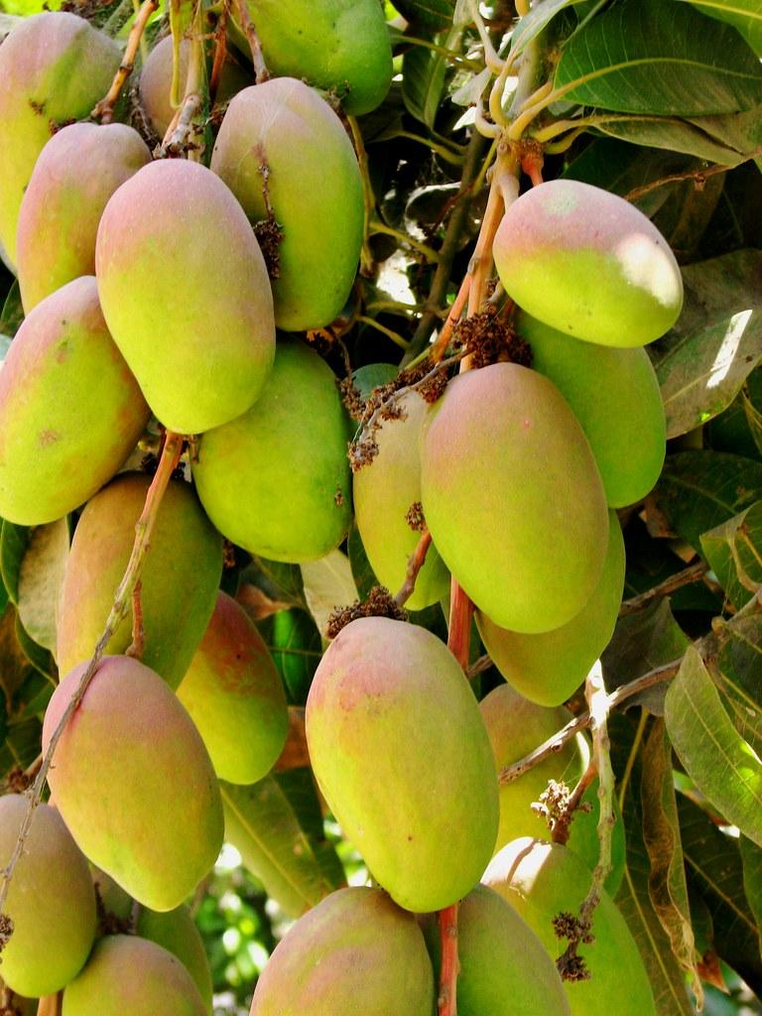
Haiku
Fanihis eat fruit -
sweet, juicy, yellow mangoes.
Will they share with me?
~fcw©2022
https://www.kidzone.ws/poetry/haiku.htm
5 syllables
7 syllables
5 syllables

Slide 16
Diamante
Fanihi
furry, fast
flying, gliding, soaring
freedom, colonies, skulk, independent
roaming, running, slinking
bushy, quick
Fox
~fcw©2022
https://poetry4kids.com/lessons/how-to-write-a-diamante-poem/
Noun
Adjective, Adjective
Verb, Verb, Verb
Noun, Noun, Noun, Noun
Verb, Verb, Verb
Adjective, Adjective
Noun

Slide 17
Cinquain
Island
Green gem on blue
Embracing warm sunshine
Feeling joyful, comfortable
My home
~fcw©2022
https://youtu.be/a8VjxcSfENY
Tell a story
Line 1: Title (noun) - 1 word / 2 syllables
Line 2: Description - 2 words / 4 syllables
Line 3: Action - 3 words / 6 syllables
Line 4: Feeling (phrase) - 4 words / 8 syllables
Line 5: Title (synonym for the title) - 1 word / 2 syllables

